Slide 1

Richfield Public Schools,
ISD 280
Public Hearing for Taxes Payable in 2022
December 6, 2021
Presented By:
Craig holje,
Chief human resources & administrative officer

Slide 2
Minnesota State Law Requires:
A Public Meeting…
  Between November 25th & December 28th
  At 6:00 PM or later
  May be part of regularly scheduled meeting
  Must allow for public comments
  May adopt final levy at same meeting
…and Presentation of:
  Current year budget
  Proposed property tax levy
Notes:
Meeting can occur on the 25th!

Slide 3
Hearing
Agenda
__________
  Background Information on School Funding
  District’s Budget
  District’s Proposed Tax Levy for Taxes Payable in 2022
  Public Comments

Slide 4
MN Legislature Must Set Funding for Minnesota Public Schools
Minnesota Constitution ARTICLE XIII
MISCELLANEOUS SUBJECTS
Section 1
“UNIFORM SYSTEM OF PUBLIC SCHOOLS. The stability of a republican form of government depending mainly upon the intelligence of the people, it is the duty of the legislature to establish a general and uniform system of public schools. The legislature shall make such provisions by taxation or otherwise as will secure a thorough and efficient system of public schools throughout the state.”

Slide 5
Funding is Highly Regulated
As a result…
  State Sets:
  Formulas which determine revenue; most revenue based on specified amounts per pupil
  Tax policy for local schools
  Maximum authorized property tax levy (districts can levy less but not more than amount authorized by state, unless approved by voters in November)
  State also authorizes school board to submit referendums for operating and capital needs to voters for approval

Slide 6
Challenge: State Set Basic General Education Formula Lags Inflation
  Since 2002-03, state General Education Revenue formula has not kept pace with inflation
  For Fiscal Year 2021-22, an increase of 2.45% or $161 over previous year was approved
  For Fiscal Year 2022-23, an increase of 2.00% or $135 over current year was approved
Per-pupil allowance for Fiscal Year 2022-23 of $6,863 would need to increase by another $598 (8.7%) to have kept pace with inflation since 2002-03

Slide 7
Notes:
Basic General Education Formula Lags Inflation

Slide 8
Underfunding of Special Education
__________
MDE reports FY 2020 costs of providing special education programs were underfunded statewide by $673 million
MDE estimates by FY 2025 costs of providing special education statewide will be underfunded by $806 million
Underfunding of special education costs requires a transfer from regular program resources to support an underfunded program mandated by state and federal law
Primary options to bridge special education funding gap are to cut regular program budgets or increase referendum revenue, most districts have done both

Slide 9
Change in Tax Levy does not Determine Change in Budget
Tax levy is based on many state-determined formulas plus voter approved referendums
1
Some increases in tax levies are revenue neutral, offset by reductions in state aid
2
Expenditure budget is limited by state-set revenue formulas, voter-approved levies, and fund balance
3
An increase in school taxes does not always correlate to an equal increase in budget
4

Slide 10
School District Levy Cycle Differs from City/County Levy Cycle
City/County:
  Budget Year same as calendar year
  2022 taxes provide revenue for 2022 calendar year budget
Schools:
  Budget year begins July 1st and coincides with school year
  2022 taxes provide revenue for 2022-23 school fiscal year
  Budget will be adopted in June 2022

Slide 11
Budget Information
__________
All school district budgets are divided into separate funds, based on purposes of revenue, as required by law
Our District’s Funds:
  General
  Food Service
  Community Service
  Building Construction
  Debt Service
  Internal Service
  OPEB* Trust
  OPEB* Debt Service
  *Other Post-Employment Benefits
Because approval of school district budget lags certification of tax levy by six months, state requires only current year budget information be presented at this hearing. Fiscal Year 2022-23 budget will be adopted by School Board in June 2022.

Slide 13
Richfield Public Schools
Revenue – All Funds
2021-22 Budget $85,223,093

Slide 14
Richfield Public Schools
General Fund Revenue
2021-22 Budget $71,057,763

Slide 15
Richfield Public Schools
General Fund Expenditures by Program
2021-22 Budget $70,658,308

Slide 16
Richfield Public Schools
General Fund Expenditures by Object
2021-22 Budget $70,658,308

Slide 17
Payable 2022 Property Tax Levy
__________
Determination of levy
Comparison of 2021 to 2022 levies
Reasons for changes in tax levy
Impact on taxpayers

Slide 18
Property Tax Background
  Every owner of taxable property pays property taxes to various “taxing jurisdictions” (county, city/township, school district, special districts) in which property is located
  Each taxing jurisdiction sets own tax levy, often based on limits in state law
  County sends bills, collects taxes from property owners, and distributes funds back to other taxing jurisdictions

Slide 19
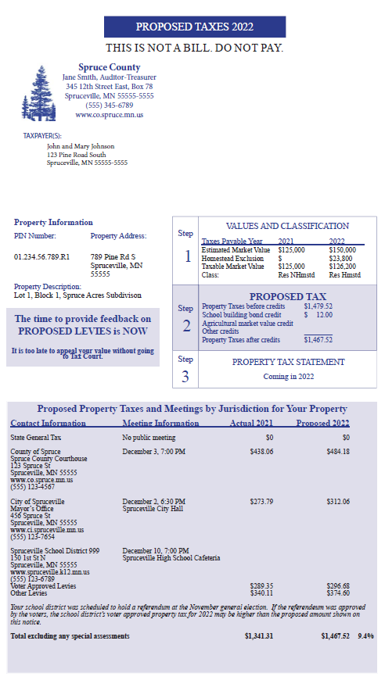
  Sample of parcel specific notice mailed to every property owner between November 11 & November 24 with information on impact of Proposed 2022 levy
  Contents:
  Proposed property taxes compared to last year
  By taxing jurisdiction
  Contains time and place of public meetings
  By voter approved and other for school district

Slide 20
School District Property Taxes
  Each school district may levy taxes in over 40 different categories
  Maximum levy amounts for each category are set by:
      State law
      Voter approval
Minnesota Department of Education (MDE) calculates levy maximums for each district

Slide 21
Property Tax Background
School District Property Taxes
  Key steps in process are summarized on next slide
  Any of these steps may affect taxes on a parcel of property, but district has control over only 1 of 7 steps

Slide 22
School District Property Tax Process
Step 2. Legislature sets formulas for tax capacity. (E.g., for homestead residential property, tax capacity = 1% of first $500,000 in value + 1.25% of value over $500,000.) These formulas determine how much of tax burden will fall on different types of property.
Step 3. County Auditor calculates tax capacity for each parcel of property in county (based on values from step 1 and tax capacity formulas from step 2), as well as total tax capacity for each school district.
Step 1. City or County Assessor determines estimated market value for each parcel of property in county.
Step 4. Legislature sets formulas which determine school district levy limits. These are maximum amounts of taxes school districts can levy in every category.
Step 6. School Board adopts a proposed levy in September, based on limits set in step 5. After a public hearing, board adopts a final levy in December. Final levy cannot be more than proposed levy, except for amounts approved by voters.
Step 5. Minnesota Department of Education calculates detailed levy limits for each school district, based on formulas approved by Legislature in step 4. These limits tell districts exact amounts that can be levied in every category.
Step 7. County Auditor divides final levy (determined by school board in step 6) by district’s total tax capacity (determined in step 3) to determine tax rate needed to raise proper levy amount. Auditor multiplies this tax rate times each property’s tax capacity, to determine school tax for that property.*
Step 7*. For certain levy categories (referendum, equity & transition levies), tax rates & levy amounts are based on referendum market value, rather than tax capacity.

Slide 23
Schedule of Events in Approval of District’s 2021 (Payable 2022) Tax Levy
September 8: MDE prepared and distributed first draft of levy limit report setting maximum authorized levy
September 20: School Board approved proposed levy amounts
Mid-November: County mailed “Proposed Property Tax Statements” to all property owners
December 6: Public hearing on proposed levy at regular meeting
Following hearing, School Board will certify final levy amounts

Slide 24
Overview of Proposed Levy
Payable in 2022
  Proposed property tax levy for 2022 is an increase from 2021 of $1,042,026 or 3.9%
  Reasons for major increases and decreases in levy are included on following slides

Slide 26
Explanation of Levy Changes
Categories: General Fund – Voter Approved Capital Project/Technology Levy
Change: +$175,314
Use of Funds: Technology costs
Reason for Change:
  Levy is based on voter approved tax rate applied to tax base
  District’s tax base increased

Slide 27
Explanation of Levy Changes
Categories: General Fund – Reemployment
Change: -$100,000
Use of Funds: Unemployment expenditures
Reason for Change:
  Levy is based on anticipated unemployment expenditures. The district is anticipating lower unemployment expenditures for the next fiscal year.

Slide 28
Explanation of Levy Changes
Category: General Fund – Prior Year Adjustments
Change: +$726,188
Use of Funds: Various
Reason for Change:
  Each year, initial levies are based on estimates of enrollment, values, and expenditures for future years
  In later years, estimates are updated, and levies are retroactively adjusted

Slide 29
Explanation of Levy Changes
Category: Debt Service Fund – Reduction for Debt Excess
Change: +$189,193
Use of Funds: Payments on bonds
Reason for Change:
  Districts are required to levy at 105% of debt service payment amounts to cover delinquencies in tax collections
  Because delinquencies are generally less than 5%, most districts gradually build up fund balances in debt service funds
  Formulas in state law determine adjustments to tax levy for debt excess balances
  Debt Excess levy reduction for 2022 is less than 2021 resulting in a levy increase

Slide 30
Factors Impacting Individual
Taxpayers’ School Taxes
Many factors can cause tax bill for an individual property to increase or decrease from year to year
Changes in value of individual property
Changes in total value of all property in District
Increases or decreases in levy amounts caused by changes in state funding formulas, local needs and costs, voter-approved referendums, and other factors

Slide 31
Four Year School Levy Comparison
  Following slides show examples of changes in school district portion of property taxes from 2019 to 2022
  Examples include school district taxes only
  All examples are based on a 11.9% increase in property value over this four-year period
      Actual changes in value may be more or less than this for any parcel of property
      Intended to provide a fair representation of what happened to school district property taxes over this period for typical properties

Slide 32
Impact on Taxpayers
  Examples are for property in City of Richfield
  Amounts for 2022 are preliminary estimates, based on best available data – final amounts could change slightly
  Estimates prepared by Ehlers, District’s municipal financial advisors
Notes:
Use for out-state districts

Slide 36
Minnesota Homestead Credit Refund “Circuit Breaker”
  Has existed since 1970s
  Available each year to owners of homestead property (applies to taxes paid on house, garage and one acre for ag homestead property)
  Annual income must be approximately $116,180 or less (income limit is higher if you have dependents)
  Sliding scale - refund based on income and total property taxes
  Maximum refund for homeowners is $2,840
  Also available to renters
  Complete state tax form M-1PR (www.revenue.state.mn.us)

Slide 37
Minnesota Special Property Tax Refund
Available each year to owners of homestead properties with a gross tax increase of at least 12% and $100 over prior year
Helpful in first year after referendum
Refund is 60% of amount by which tax increase exceeds greater of 12% or $100, up to a maximum of $1,000
No income limits
Complete state tax form M-1PR (www.revenue.state.mn.us)

Slide 38
Senior Citizen Property Tax Deferral
  Allows people age 65 and older with household income of $60,000 or less to defer a portion of property taxes on home
  Must have lived in, owned, and homesteaded for last 15 years
  Limits maximum amount of property tax paid to 3% of household income
  Additional taxes are deferred, not forgiven
  Provides predictability; amount of tax paid will not change while participating in program
  Deferred property taxes plus accrued interest must be paid when home is sold or homeowner(s) dies

Slide 39
Next Steps
Board will accept public comments on proposed levy
1
Board will certify 2022 property tax levy
2

Slide 40
Public comments

