Slide 1

Richfield Public Schools, ISD 280
Public Hearing for Taxes Payable in 2023
December 5, 2022
Presented By:
Craig holje,
chief human resources & administrative officer

Slide 2
Minnesota State Law Requirements
A Public Meeting…
Between November 25th & December 28th
At 6:00 PM or later
May be part of regularly scheduled meeting
Must allow for public comments
May adopt final levy at same meeting
…and Presentation of:
Current year budget
Proposed property tax levy
Notes:
Meeting can occur on the 25th!

Slide 3
Hearing Agenda
  Background Information on School Funding
  District’s Budget
  District’s Proposed Tax Levy for Taxes Payable in 2023
  Public Comments
Notes:
Meeting can occur on the 25th!

Slide 4
MN Legislature Must Set Funding for
Minnesota Public Schools
Minnesota Constitution ARTICLE XIII
MISCELLANEOUS SUBJECTS
Section 1
“UNIFORM SYSTEM OF PUBLIC SCHOOLS. The stability of a republican form of government depending mainly upon the intelligence of the people, it is the duty of the legislature to establish a general and uniform system of public schools. The legislature shall make such provisions by taxation or otherwise as will secure a thorough and efficient system of public schools throughout the state.”

Slide 5
As a Result, Funding is Highly Regulated
State Sets:
  Formulas which determine revenue; most revenue based on specified amounts per pupil
  Tax policy for local schools
  Maximum authorized property tax levy
    Districts can levy less, but not more than amount authorized by state, unless approved by voters in November
State also authorizes school board to submit referendums for operating & capital needs to voters for approval

Slide 6
Basic General Education Formula Lags Inflation
  Since 2002-03, state General Education Revenue formula has not kept pace with inflation
  For Fiscal Year 2021-22, an increase of 2.45% or $161 over previous year was approved
  For Fiscal Year 2022-23, an increase of 2.00% or $135 over previous year was approved
Per-pupil allowance for Fiscal Year 2022-23 of $6,863 would need to increase by another $1,263 (18.4%) to have kept pace with inflation since 2002-03, resulting in an allowance of $8,126

Slide 7
Notes:
Basic General Education Formula Lags Inflation

Slide 8
Underfunding of Special Education
According to MN Department of Education (MDE):
FY 2020 costs of providing programs were underfunded statewide by $591 million
By FY 2025 costs of providing programs statewide will be underfunded by $806 million
Primary options to bridge funding gap are to cut regular program budgets or increase referendum revenue, most districts have done both

Slide 9
Change in Tax Levy does not Determine
Change in Budget
Tax levy is based on many state-determined formulas plus voter approved referendums
Some increases in tax levies are revenue neutral, offset by reductions in state aid
Expenditure budget is limited by state-set revenue formulas, voter-approved levies & fund balance
An increase in school taxes does not always correlate to an equal increase in budget

Slide 10
Difference in Levy Cycles
School District:
Budget year begins July 1st
2023 taxes provide revenue for 2023-24 fiscal year
Budget adopted in June 2023
City/County:
Budget year begins Jan. 1st
2023 taxes provide revenue for 2023 calendar year budget

Slide 11

Budget Information
__________
School district budgets are divided into separate funds, based on purposes of revenue, as required by law.
Our District’s Funds:
  General
  Food Service
  Community Service
  Building Construction
  Debt Service
  Trust
  Internal Service
  OPEB* Trust
  OPEB* Debt Service
  *Other Post-Employment Benefits
Because approval of school district budget lags certification of tax levy by six months, state requires only current year budget information be presented at this hearing. Fiscal Year
2023-24 budget will be adopted by School Board in June 2023.

Slide 13
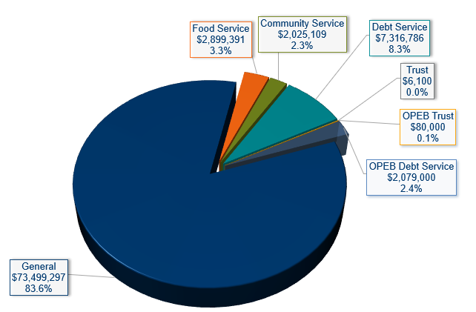
Revenue
- All Funds -
2022-23 Budget $87,905,683

Slide 14
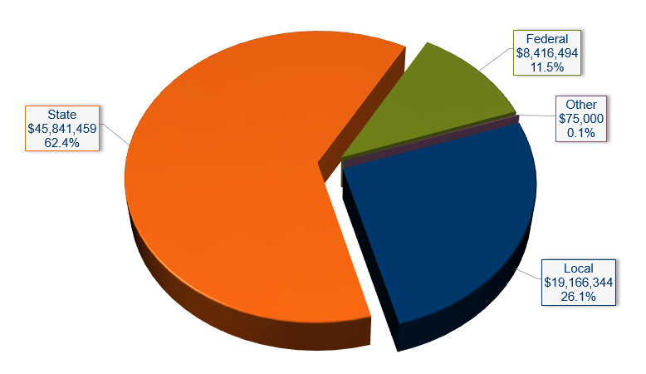
General Fund Revenue
2022-23 Budget $73,499,297

Slide 15
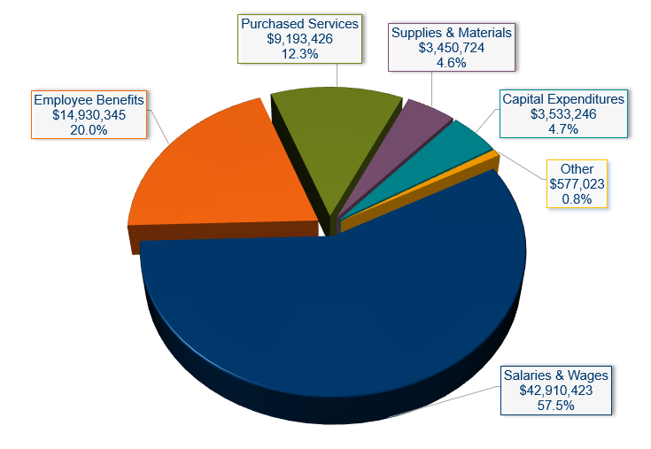
General Fund Expenditures
- by Object -
2022-23 Budget $74,595,187

Slide 16
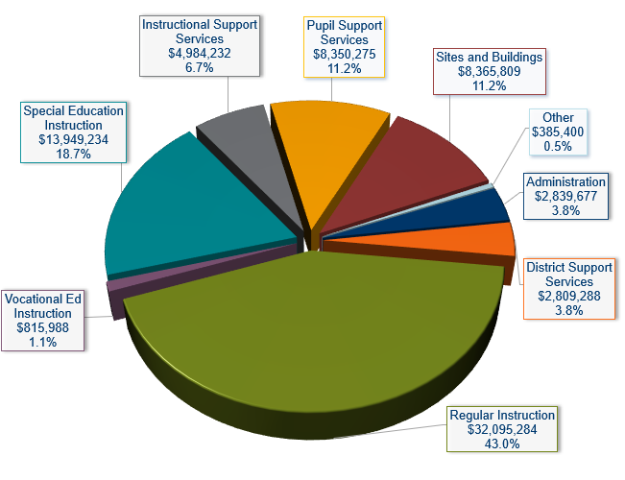
General Fund Expenditures
- by Program -
2022-23 Budget $74,595,187

Slide 17
Payable 2023 Property Tax Levy
Determination of levy
Comparison of 2022 to 2023 levies
Reasons for changes in tax levy
Impact on taxpayers

Slide 18
Property Tax Background
  Every owner of taxable property pays property taxes to various “taxing jurisdictions” (county, city/township, school district, special districts) in which property is located
  Each taxing jurisdiction sets own tax levy, often based on limits in state law
  County sends bills, collects taxes from property owners & distributes funds back to other taxing jurisdictions

Slide 19
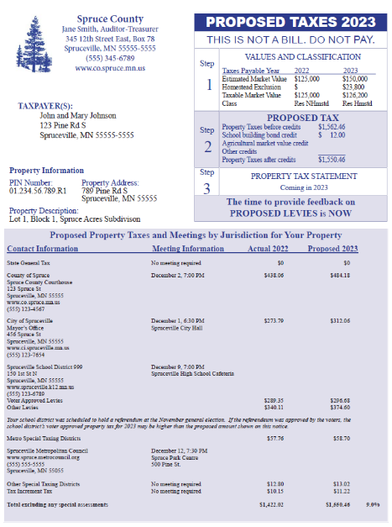
  Sample of parcel specific notice mailed to every property owner between November 11 & November 24
  Contents:
  Proposed property taxes compared to last year
    By taxing jurisdiction
    By voter approved & other for school district
  Time & place of public meetings

Slide 20
School District Property Taxes
  Each school district may levy taxes in over 40 different categories
  Maximum levy amounts (calculated by MDE) for each category are set by:
    State law
    Voter approval
  Property Tax Process
    Key steps in process are summarized on next slide
    Any of these steps may affect taxes on a parcel of property, but district has control over only 1 of 6 steps

Slide 21
School District Property Tax Process
__________
Step 1
City or County Assessor determines estimated market value for each parcel of property.
Step 2
Legislature sets formulas for tax capacity and school district levy limits.
Step 3
County Auditor calculates tax capacity for each parcel of property, as well as total tax capacity for each school district.
Step 4
Minnesota Department of Education calculates detailed levy limits for each school district, based on formulas approved by Legislature.
Step 5
School Board adopts a proposed levy in September. After a public hearing, board adopts a final levy in December. Final levy cannot be more than proposed levy, except for amounts approved by voters.
Step 6
County Auditor divides final levy by district’s total tax capacity to determine tax rate needed to raise levy amount.
Note: For certain levy categories, tax rates & levy amounts are based on referendum market value, rather than tax capacity.

Slide 22
Approval of District’s Tax Levy in 2022 (Payable 2023)
September 8: MDE prepared & distributed first draft of levy limit report setting maximum authorized levy
September 19: School Board approved proposed levy amounts
Mid-November: County mailed “Proposed Property Tax Statements” to all property owners
December 5: Public hearing on proposed levy at regular meeting
Following hearing, School Board will certify final levy amounts

Slide 23

Overview of District’s Proposed Tax Levy
  Proposed Payable 2023 tax levy is an increase from 2022 of $823,854 or 3.0%
  Changes by levy category and reasons for major increases & decreases in levy are included on following slides

Slide 25
Explanation of Levy Changes
Category:
General Fund - Voter Approved Operating Referendum
Change:
-$154,328
Use of Funds:
General Operating Expenses
Reason for Change:
Voter approved operating referendum authority based on current year student count that is lower than prior year
Notes:
*Duplicate slide if you need more explanation slides
-Right click in text box and select, “Edit Text”

Slide 26
Explanation of Levy Changes
Category:
General Fund – Capital Project Referendum
Change:
+$383,601
Use of Funds:
Technology costs
Reasons for Change:
Levy is based on voter approved tax rate applied to tax base
District’s tax base increased
Notes:
*Duplicate slide if you need more explanation slides
-Right click in text box and select, “Edit Text”

Slide 27
Explanation of Levy Changes
Category:
Debt Service Fund
Change:
+$765,588
Use of Funds:
Acquisition & betterment of school sites & facilities as authorized in a referendum in 2017
Reasons for Change:
Levies are coordinated with other capital & debt levies to maintain a debt service tax rate that is lower than taxes payable 2022.
District voters authorized the issuance of up to $86,800,000 in bonds in 2017 election. In 2018, the District issued bonds totaling $84,615,000, leaving a remaining unused authority of $2,185,000. District issued the remaining $2,185,000 in 2022.
Notes:
*Duplicate slide if you need more explanation slides
-Right click in text box and select, “Edit Text”

Slide 28
Factors Impacting Individual
Taxpayers’ School Taxes
Many factors can cause a tax bill for an individual property to increase or decrease from year to year
Changes in value of individual property
Changes in total value of all property within District
Increases or decreases in levy amounts caused by changes in state funding formulas, local needs & costs, voter-approved referendums & other factors

Slide 29
Four Year School Levy Comparison
  Examples include school district taxes only & are shown based on no change and a 17.3% increase in property value for residential homes over the past four years
    Actual changes in value may be more or less than this for any parcel of property
    Intended to provide a fair representation of what happened to school district property taxes over this period for typical properties
  Examples are for property in City of Richfield
  Amounts for 2023 are preliminary estimates; final amounts could change slightly
  Estimates prepared by Ehlers (District’s municipal financial advisors)

Slide 31
Estimated Changes in School Property Taxes, 2020-23
Based on No Changes in Property Value

Slide 32
Estimated Changes in School Property Taxes, 2020-23
Based on No Changes in Property Value

Slide 33
Estimated Changes in School Property Taxes, 2020-23
Based on 17.3% Cumulative Changes in Property Value

Slide 34
Estimated Changes in School Property Taxes, 2020-23
Based on 17.3% Cumulative Changes in Property Value

Slide 35
State Property Tax Refunds & Deferral
Homestead Credit Refund
Available for all homestead property, both residential and agricultural (house, garage and one acre (HGA) only)
Refund is sliding scale, based on total property taxes and income (maximum refund is $2,930 for homeowners and $2,280 for renters)
Special Property Tax Refund
Available for all homestead property, both residential & agricultural (HGA only) with a gross tax increase of at least 12% and $100 over prior year
Refund is 60% of tax increase that exceeds greater of 12% or $100 (max $1,000)
Senior Citizen Property Tax Deferral
Allows people 65 years of age or older with household income of $60,000 or less to defer a portion of property taxes on their home
Deferred property taxes plus accrued interest must be paid when home is sold or homeowner(s) dies
35

Slide 36
Next Steps
Board will accept public comments on proposed levy
Board will certify 2023 property tax levy

Slide 37
Public comments

